Slide 1

IST 687 – MLB Dataset
Parin Patel

Slide 2
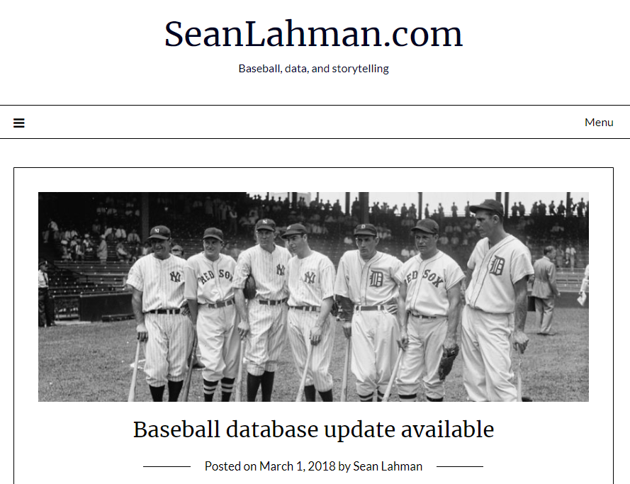
Overview of Dataset
Major League Baseball dataset spanning from 1871 to 2016 from the Lahman package
The Lahman R library contains 27 data frames
  Dataset includes offense, defense, pitching, salary, all stars, hall of famers, attendance, and team statistics
Pros:
  Widely known public database
  Plenty of resources and discussion boards
  Has a large, complex volume of data available.
Cons:
  Large volume of data:
    requires extensive cleaning
    May get “lost in the information”- since there are a lot of variables to look at.
    Need to be slightly familiar with baseball

Slide 3
Summary of Project
Batting Stats – Hits
Total Games per year
Batting Stats – Hitsa
Batting Stats – Runs
Batting Stats – RBIs
Batting Stats – Home Runs
Pitching Stats – ERA
Total League Annual Salary
Attendance
Highest MLB Salary by Year
Top 5 Average Salaries
Salary of Hall of Fame Players
Top 5 Salaries and Team Wins
Top 5 Salaries and Team Attendance
Logistic Regression Model for Predicting Hitters’ All Star Appearances
Logistic Regression Model for Predicting Hitters’ All Star Appearances
RandomForest Model for Hitters HOF
Linear Model for Teams Wins
RandomForest Model for Salary Importance
World Series Wins using LM()
Next Steps

Slide 4
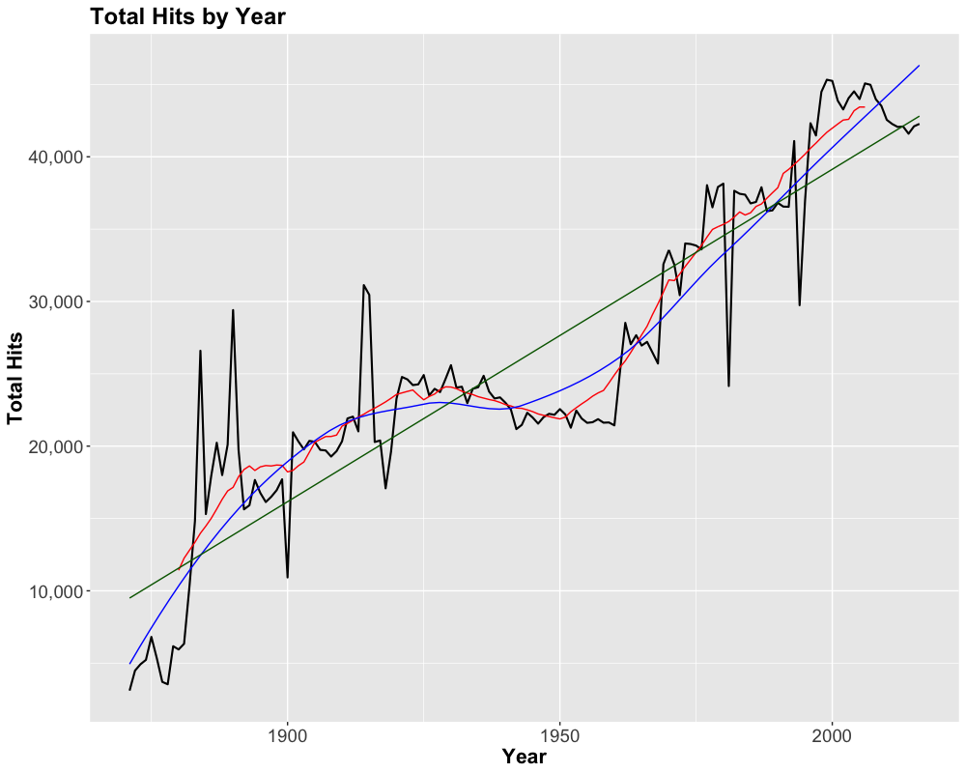
Batting Stats – Hits
Moving average using rollmean() in zoo library (k = 20)
Linear model
  R² = 0.8241
  p-value: < 2.2e-16
LOESS model using loess() function in ggplot2 (span = 0.75)
–– Hits
–– LOESS Model
–– Linear Model
–– Moving Average
(k = 20)

Slide 5
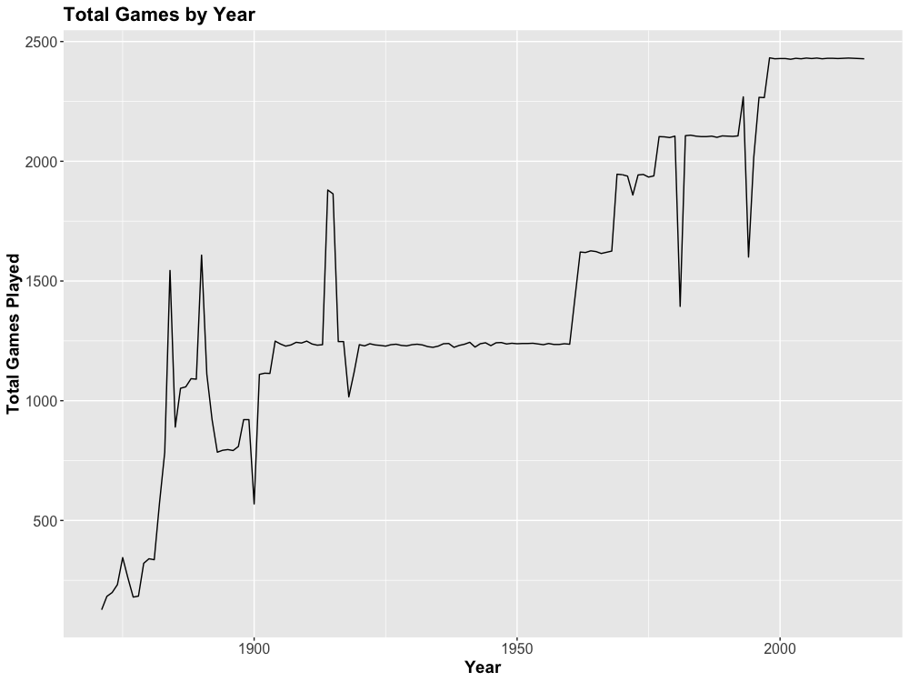
Total Games per year
MLB currently has 30 teams
  Only 16 teams in 1903
Each team has 162 scheduled games per year
  Some games delayed by weather may be cancelled
  A 163rd game may be played as a tie-breaker
1981 strike cancelled over 700 midseason games
1994–1995 strike ended the 1994 season 7 weeks early
MLB had three leagues in the 1914–1915 seasons, and two since
1960’s MLB expansion
Strike shortened seasons

Slide 6
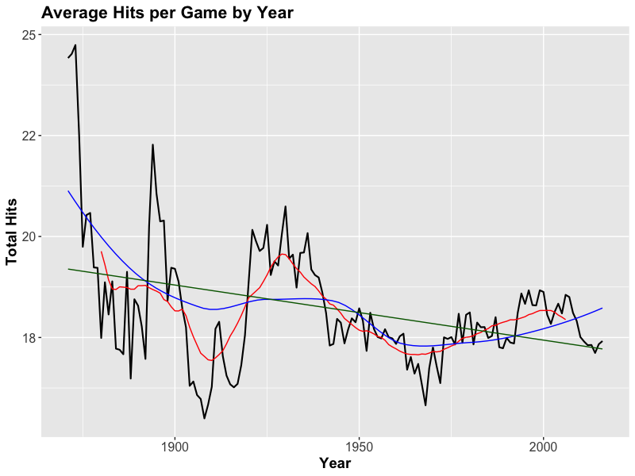
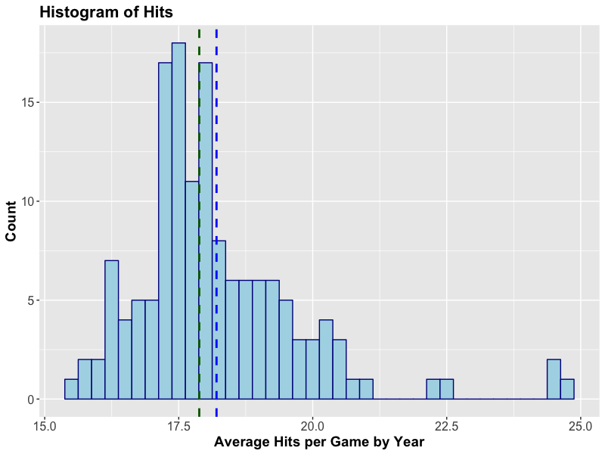
Batting Stats – Hits
median
mean
–– Hits –– LOESS Model –– Linear Model –– Moving Average (k = 20)

Slide 7
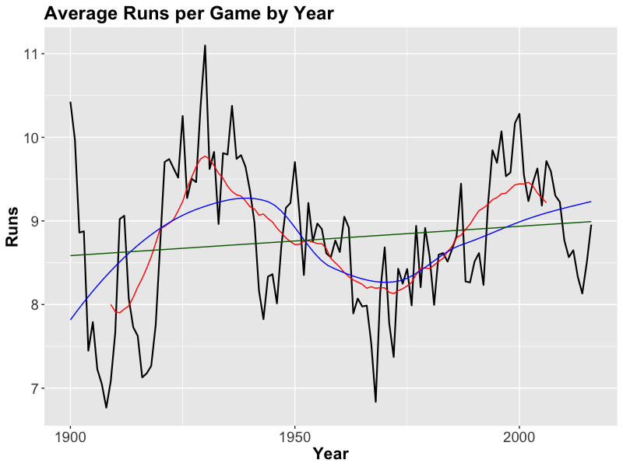
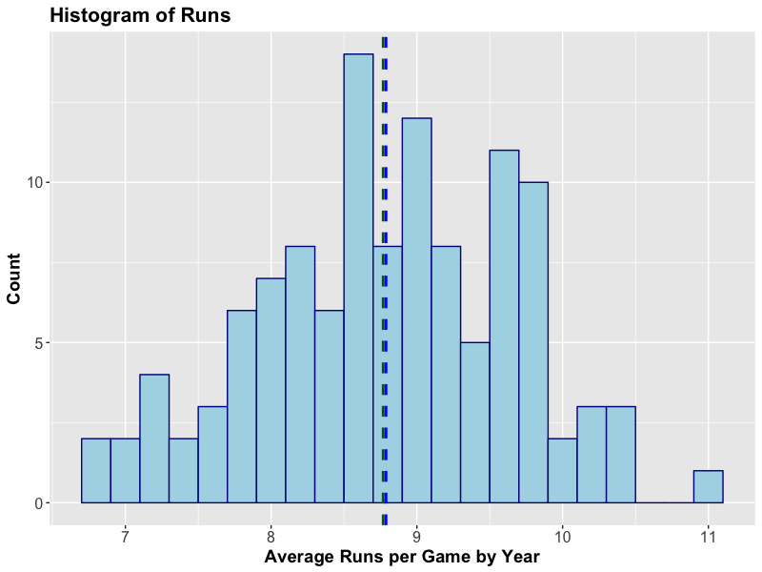
Batting Stats – Runs
–– Runs –– LOESS Model –– Linear Model –– Moving Average (k = 20)
Notes:
Ignored data before 1900. All seasons were over 10 runs per game, with some approaching 20 runs per game

Slide 8
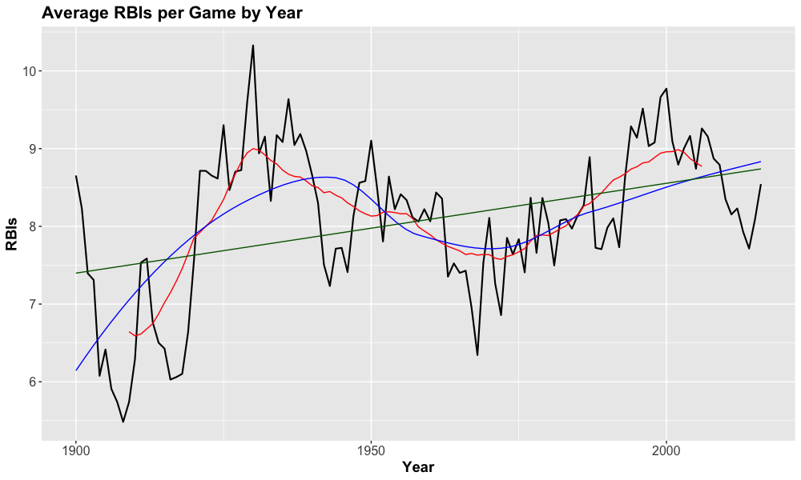
Batting Stats – RBIs
–– RBIs
–– LOESS Model
–– Linear Model
–– Moving Average
(n = 20)
Notes:
Removed data prior to 1900 due to extreme outliers. One year as high as 14, another as low as about 3.

Slide 9
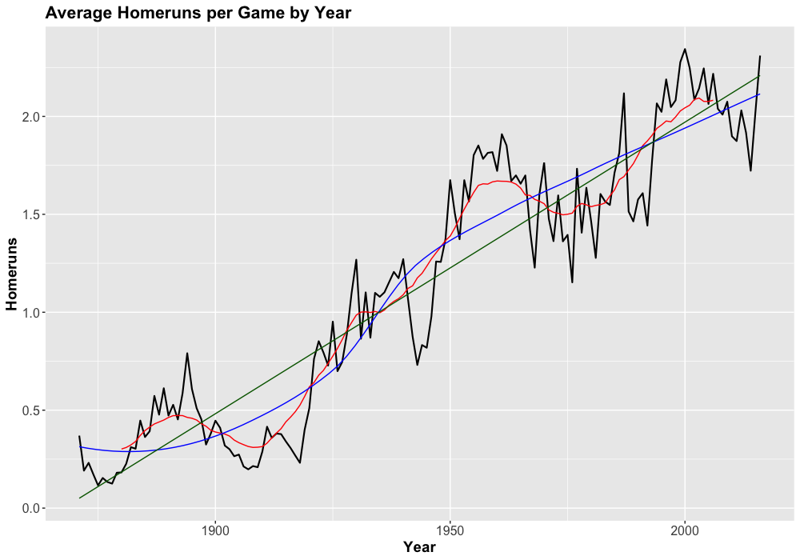
Batting Stats – Home Runs
Strength of Linear Model
R2 = 0.8663
p-value: < 2.2e-16
–– Homeruns
–– LOESS Model
–– Linear Model
–– Moving Average
(n = 20)

Slide 10
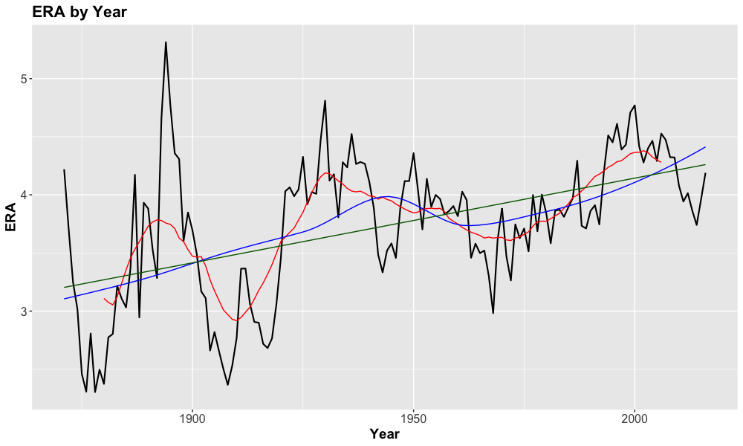
Pitching Stats – ERA
–– ERA
–– LOESS Model
–– Linear Model
–– Moving Average
(n = 20)

Slide 11
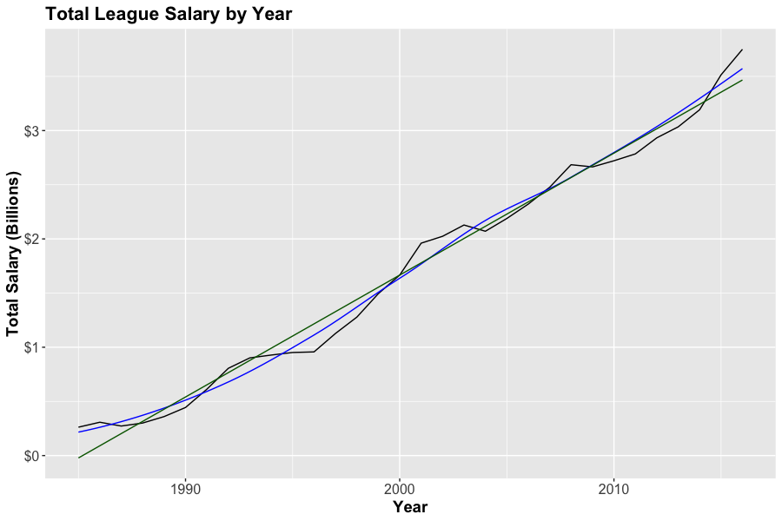
Total League Annual Salary
Strength of Linear Model
R2 = 0.9845
p-value: < 2.2e-16
–– Salary
–– LOESS Model
–– Linear Model

Slide 12
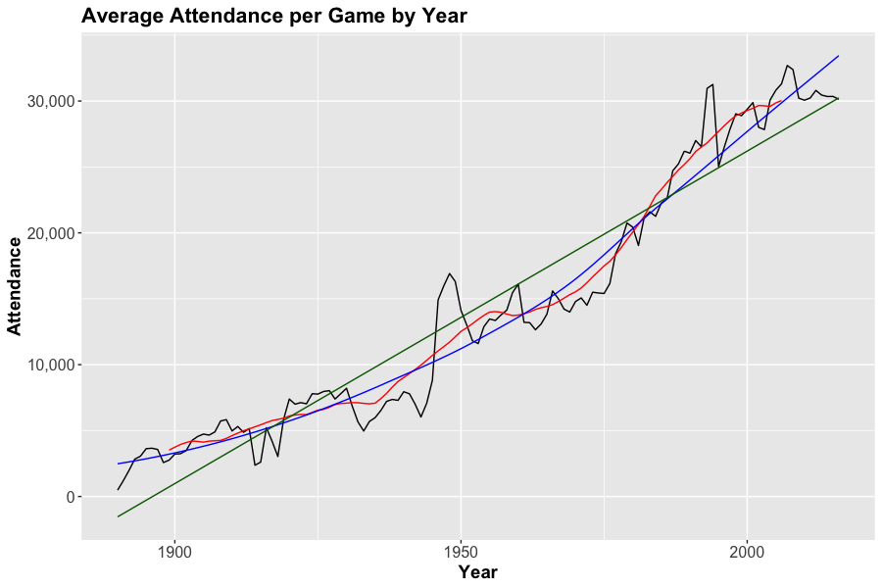
Attendance
Strength of Linear Model
R2 = 0.9181
p-value: < 2.2e-16
–– Attendance
–– LOESS Model
–– Linear Model
–– Moving Average
(n = 20)
Notes:
Missing values prior to 1901. Not all teams recorded attendance consistently. Teams with missing attendance for a given year were assigned the median attendance for that year.

Slide 13
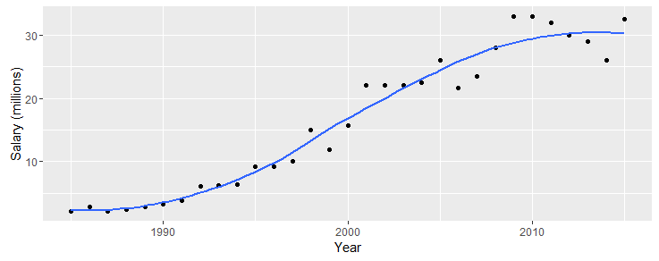
Highest MLB Salary by Year
Based on highest player paid per year, grouped by total team salaries
Highest:
Alex Rodriguez- $33,000,000.00
Notes:
teamSalaries <- Salaries %>%
group_by(lgID, teamID, yearID) %>%
summarise(Salary = sum(as.numeric(salary))) %>%
group_by(yearID, lgID) %>%
arrange(desc(Salary))
# Highest paid players each year:
HighestSal_byear <- Salaries %>%
group_by(yearID) %>%
filter(salary == max(salary))
maxPlayers <- bind_rows(lapply(HighestSal_byear$playerID, playerInfo)) %>%
select(-playerID)
HighestSal_byear <- bind_cols(maxPlayers, HighestSal_byear)
#Plot highest salary by year - use Highest paid player from ^
salarybyYear_plot<- ggplot(HighestSal_byear, aes(x = yearID, y = salary/1e6)) +
geom_point() +
geom_smooth(se = FALSE) +
labs(x = "Year", y = "Salary (millions)")
print(salarybyYear_plot)

Slide 14
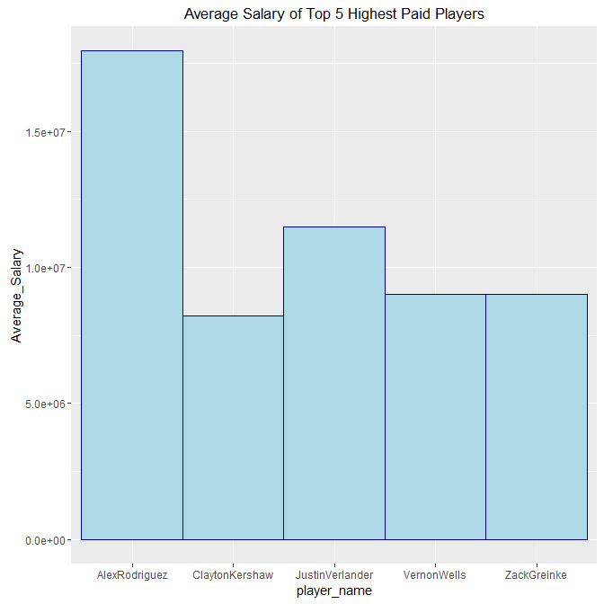
Top 5 Average Salaries
Alex Rodriguez
Clayton Kershaw
Justin Verlander
Vernon Wells
Zack Greinke
Notes:
•Two Questions:
•Who were the top 5 highest paid players?
•What is their average salary?
Alex Rodriguez $17,972,202.48
Clayton Kershaw $8,202,142.86
Justin Verlander $11,471,500.00
Vernon Wells $9,016,835.15
Zack Greinke $9,016,835.15

Slide 15
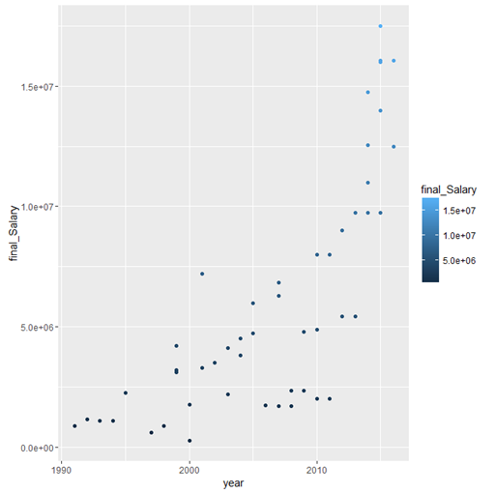
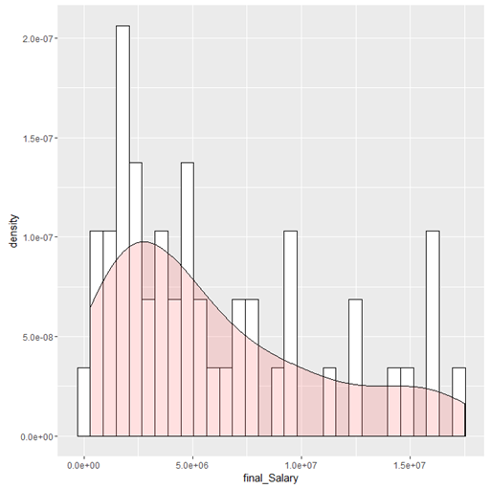
Salary of Hall of Fame Players
Salary vs Year
Salary Range of HOF Players
Notes:
Density chart on histogram:
Question: What did the final salary of Hall of Fame players look like?
-Decided to plot density on the histogram to display the frequency of salary ranges for Hall of Fame players.

Slide 16
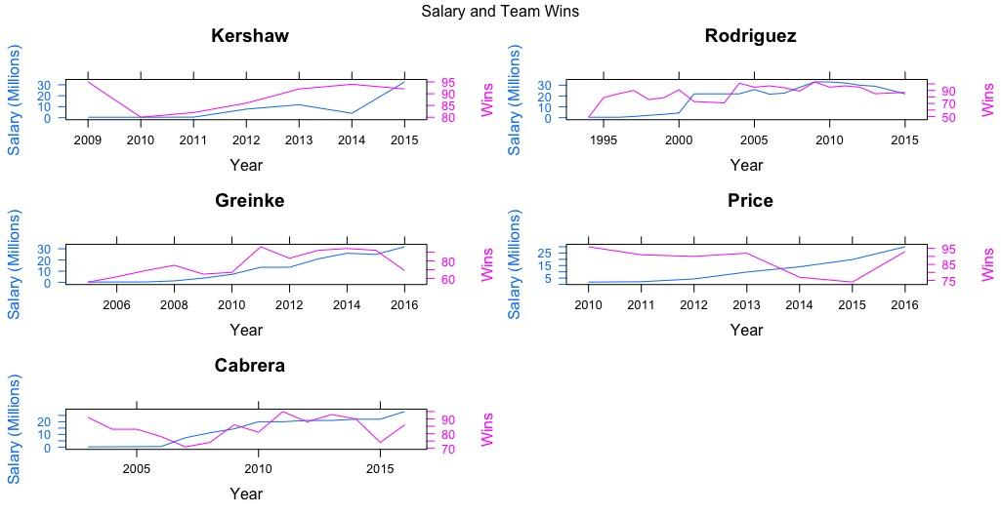
Top 5 Salaries and Team Wins
Notes:
Looking at top 5 salary and win trends combined to see if individual player salary increases overall team performance. Greinke moved to the diamondbacks

Slide 17
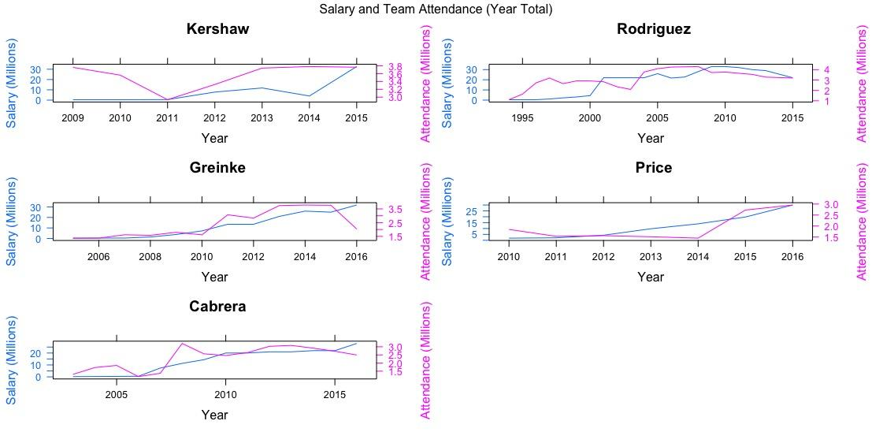
Top 5 Salaries and Team Attendance

Slide 18
Model for Predicting Hitters’ All Star Appearances
Call:
glm(formula = asAppearance ~ ., family = binomial(link = "logit"), data = as.train)
Deviance Residuals:
Min 1Q Median 3Q Max
-2.5490 -0.2799 -0.2135 -0.1714 3.1304
Coefficients:
Estimate Std. Error z value Pr(>|z|)
(Intercept) 19.7349588 2.7757849 7.110 1.16e-12 ***
birthYear -0.0159859 0.0013787 -11.595 < 2e-16 ***
weight 0.0091644 0.0013651 6.713 1.90e-11 ***
height 0.0762822 0.0120807 6.314 2.71e-10 ***
G 0.0151576 0.0013901 10.904 < 2e-16 ***
AB -0.0169273 0.0008828 -19.176 < 2e-16 ***
R 0.0182937 0.0034740 5.266 1.40e-07 ***
H 0.0453672 0.0030362 14.942 < 2e-16 ***
X2B -0.0046418 0.0050015 -0.928 0.35336
X3B -0.0110108 0.0119935 -0.918 0.35858
HR 0.0551743 0.0069754 7.910 2.58e-15 ***
RBI 0.0094905 0.0031036 3.058 0.00223 **
SB 0.0243994 0.0036063 6.766 1.33e-11 ***
CS -0.0474472 0.0105630 -4.492 7.06e-06 ***
BB -0.0053448 0.0018166 -2.942 0.00326 **
SO -0.0074015 0.0013097 -5.651 1.59e-08 ***
IBB 0.0792122 0.0073409 10.790 < 2e-16 ***
HBP -0.0054817 0.0080496 -0.681 0.49588
SH 0.1632589 0.0070484 23.162 < 2e-16 ***
SF 0.0162876 0.0129292 1.260 0.20776
GIDP 0.0112144 0.0065215 1.720 0.08550 .
Null deviance: 24820 on 53020 degrees of freedom
Residual deviance: 17976 on 53000 degrees of freedom
AIC: 18018
Number of Fisher Scoring iterations: 6
Use only non-categorical variables
Shuffled rows to randomize order of data, and split data into training and test set (80% train, 20% test)
Generate the model with glm() and a logit model
  Estimates the likelihood a player will have an All Star appearance based on their stats
The model determined that most stats were significant in predicting All Star appearances, with the exception of doubles, triples, hit-by-pitch, sacrifice fly, and grounded into double play
Notes:
Glm = generalized linear model

Slide 19
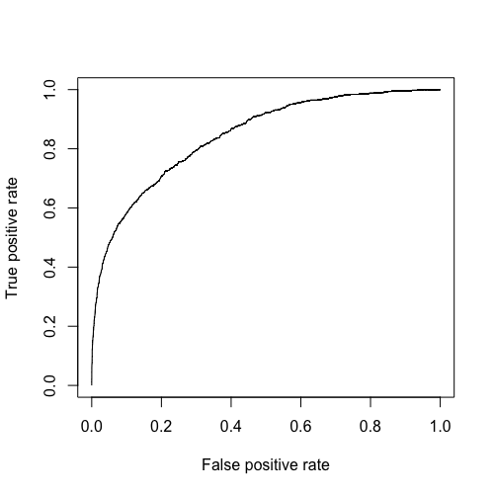
Predicting Hitters’ All Star Appearances
Calculated model accuracy by predicting values for the test data, and comparing to the actual all star appearance each year for each player
Accuracy for this model was 0.954375
Plotted the true positive vs true negative of the model using ROCR library’s prediction and performance objects
  Looking for a curve towards high true positive and low false positive
Calculated area under curve to be 0.8446
  Looking for a number closer to 1 than to 0.5
ROC Curve for All Star Appearances Logistic Regression Model
Notes:
ROC = receiver operator characteristic
Accuracy was calculated by:
Assigning any result >= 0.5 to 1, and all others 0 (1 is predicted all star appearance that year for that player, 0 is no all star appearance)
Comparing the prediction (1 or 0) to the actuals in the test data set
Assigning a correct prediction true, incorrect prediction false
Finding the mean of the incorrect predictions, with true = 1 and false = 0
Subtract 1 from the misclascified rate to find accuracy

Slide 20
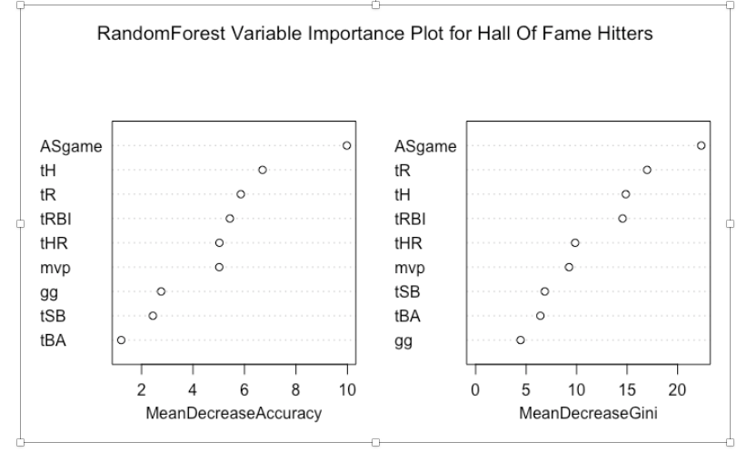
RandomForest Model for Hitters HOF
All-Star Appearance (ASgame) seem to be picking up a large portion of the variation in Hall of Fame induction for Hitters
Hits, RBIs,and runs also are significant predictors and best than HRs
Stolen Bases(SB) and base accepted (BA)don’t have much predictive ability
Type of random forest: classification. Number of trees;100, Variables each split: 2
Notes:
RabdomForest
randomForest(formula = factor(inducted) ~ tH + tHR + tR + tSB + tRBI + tBA + mvp + gg + ASgame, data = trainBat, ntree = 100, replace = TRUE, strata = factor(trainBat$inducted), keep.forest = TRUE, importance = TRUE, localImp = TRUE, proximity = TRUE, mtry = 2)
Mean Decrease

Slide 21
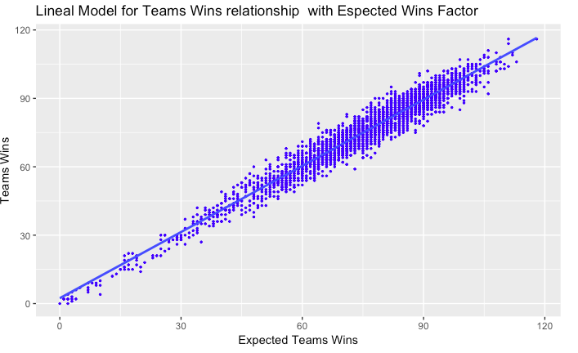
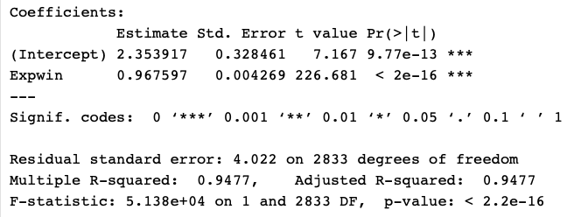
Linear Model for Teams Wins
Notes:
dfteams <-select(Teams, yearID,lgID,teamID,W,L,R,RA)# W- wins, L-losses, R-runs, RA-runs allowed
Wpct <- dfteams$R^2/(dfteams$R^2+dfteams$RA^2)# Wpct-wining percentage
Expwin <-round(Wpct*(dfteams$W+dfteams$L))# expeted numbers of wins
mutate(dfteams,Wpct,Expwin, diff=W-Expwin)
linealmodel <- lm(dfteams$W~Expwin, data = dfteams)

Slide 22
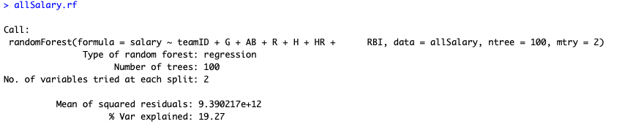
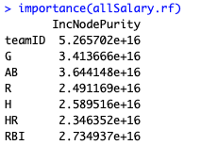
Salary Importance using RF
Used RF to identify factors that may lead to a higher salary
The model identified team as the most important factor to high salaries followed by at bats and games played
Teams make sense in baseball as there is no salary cap and teams with more money and known for overpaying players (Yankees, Red Sox, Cubs)

Slide 23
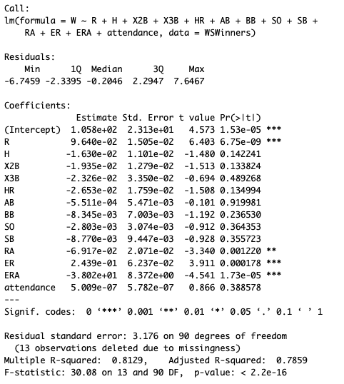
World Series Wins - Importance using LM
Used lm() to look at the total list of World Series winners to determine what factors throughout the season influenced their win
The model confirmed that in order to be great throughout the season and win a World Series, you need to score runs, and not let the opposition score
It would confirm the theory that if you score more runs than the other team, you will win 100% of the time

Slide 24
Next Steps...
Look at pitching and defensive statistics
Plotting coordinate heatmaps of hit and homerun locations
Plotting coordinate heatmaps of pitch locations
Finding correlation with players pre-MLB history to their MLB performance (college, nationality, minor league, etc.)
SVM model to predict players’ future salaries

